Slide 1
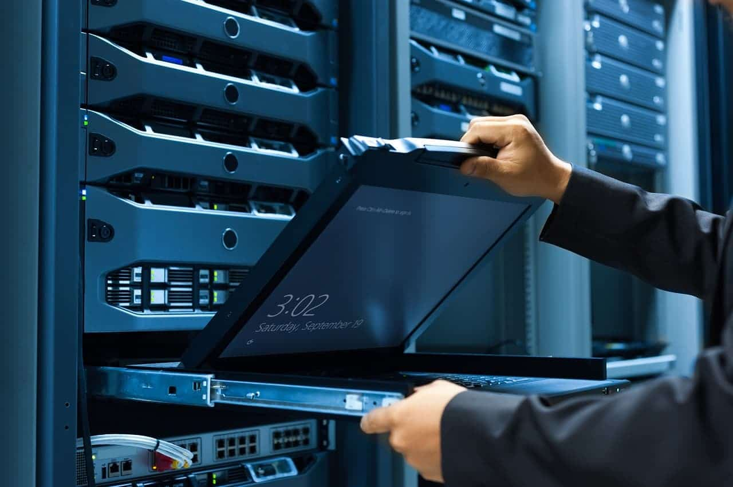
Unit - 1
Installing Windows Server :
Prepare an installation plan, Prepare the server hardware, Set up the server hardware, Install an operating system

Slide 2
Systems Administrator
A system administrator is a professional who maintains computer systems, servers, and networks of their clients.
They are required to understand the specific requirement of their clients and accordingly recommend or suggest computer systems designs for them.

Slide 3
Systems Administrator Job Roles and Responsibilities
Systems administrators are responsible for managing the server and network hardware lifecycles, documentation, and security.
The sysadmin may also advise the business on emerging technologies and may have a role in capacity planning.
The primary skill of a systems administrator is problem-solving.
Sysadmins typically have a variety of skills and work with a wide range of technologies.

Slide 4
Common Sysadmin Responsibilities
Installing, configuring, and managing server hardware, applications, and network components
Managing the server lifecycle
Monitoring server performance
Providing capacity planning and growth
Managing user and group accounts for access control
Troubleshooting

Slide 5
Common Sysadmin Responsibilities
Working with other information technology (IT) teams, possibly including the service desk, developers, desktop support
Accepting escalated service desk tickets
Managing different technologies, such as databases, virtualization, cloud, backups, disaster recovery
Managing network services, such as web, email, name resolution, Internet protocol (IP) address configuration
Providing documentation
Advising the business on security policies, and implementing those policies

Slide 6
Servers Versus Workstations
Workstations are usually assigned to end users.
These devices do not tend to have redundant hardware and often do not have high-performance capabilities.
Workstations also typically have a client OS installed.
These OSs are optimized for a single user
Server hardware is designed for high performance and redundancy.
Often, a server includes multiple network interface cards (NICs), power supplies, and HDDs.
The server may also have a great deal of random access memory (RAM) and multiple powerful central processing units (CPUs).
The server’s form factor may be measured in 1.75 inch (44.45 mm) units that permit it to be installed into standardized server racks.
The server will be 19” wide and one or more units high. Servers typically have a server OS installed.

Slide 7
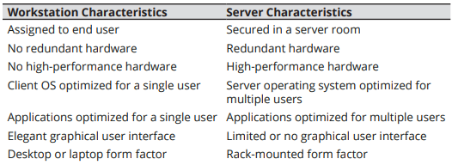
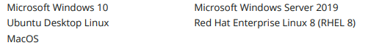
Servers Versus Workstations

Slide 8
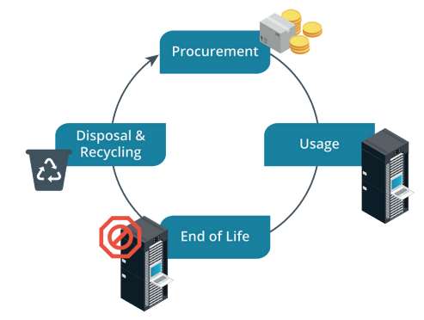
Server Lifecycle
Server administrators are responsible for the lifecycle of the server.
The term "lifecycle" normally specifies four phases: procurement, usage, end of life, and disposal/recycling.

Slide 9
The Four Major Subsystems
Computer systems are specified based on the four major subsystems, which are also us
The four subsystems are the following:
Processor—the CPU represents the amount of processing power the system has available.
Memory—the RAM represents storage capacity available to the CPU for quick access to data.eful measurements for the system’s performance.

Slide 10
The Four Major Subsystems
Storage—the storage drives represent storage capacity and access speeds available for the OS and user data.
Network—the capacity for sending and receiving information across the network.

Slide 11
Installation of Windows Server 2012 R2 in VMWare

Slide 12
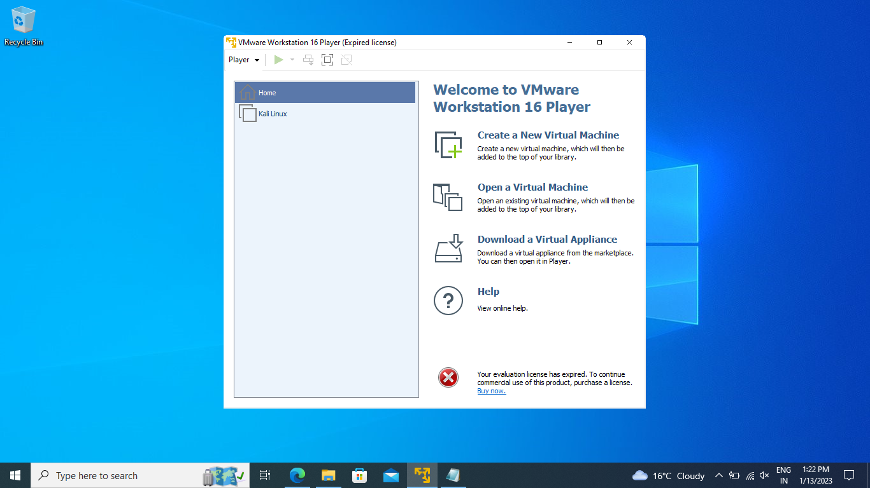

Slide 13


Slide 14
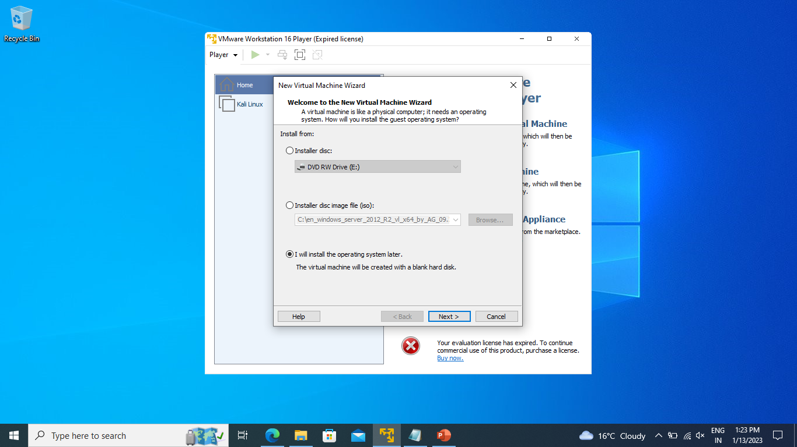

Slide 15
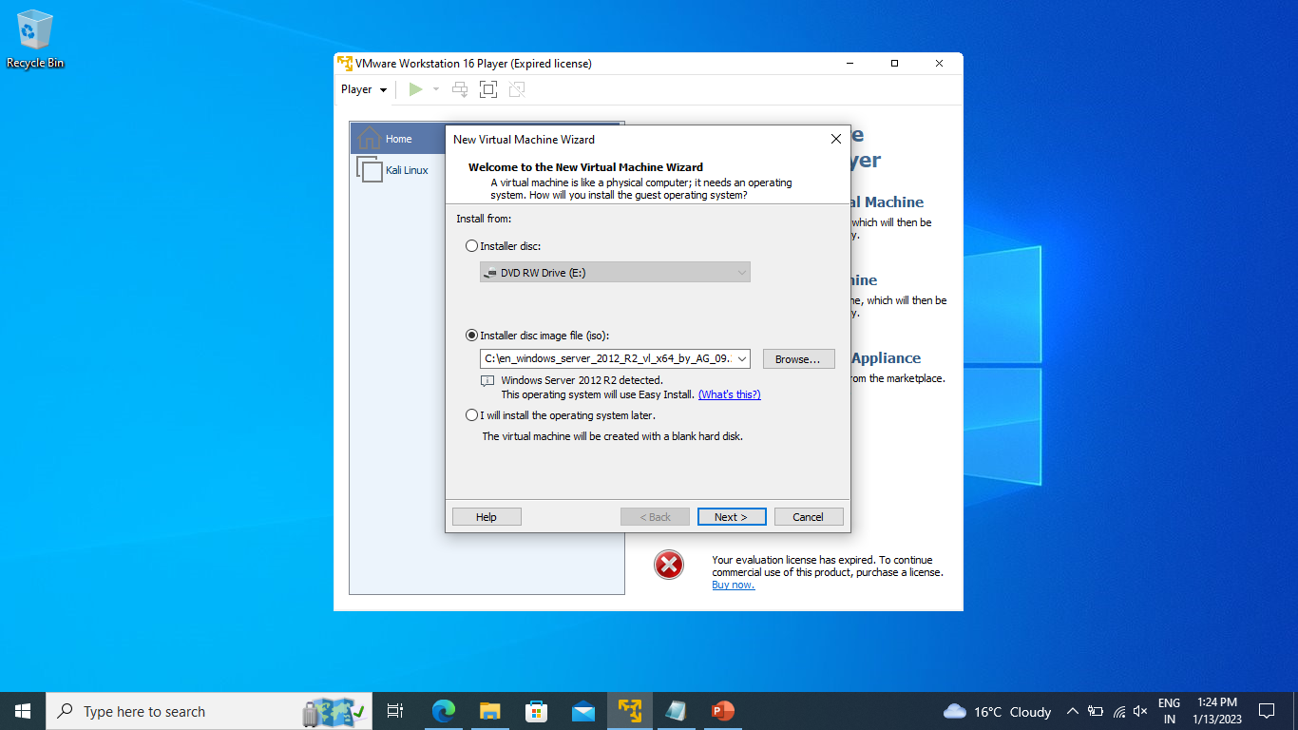

Slide 16
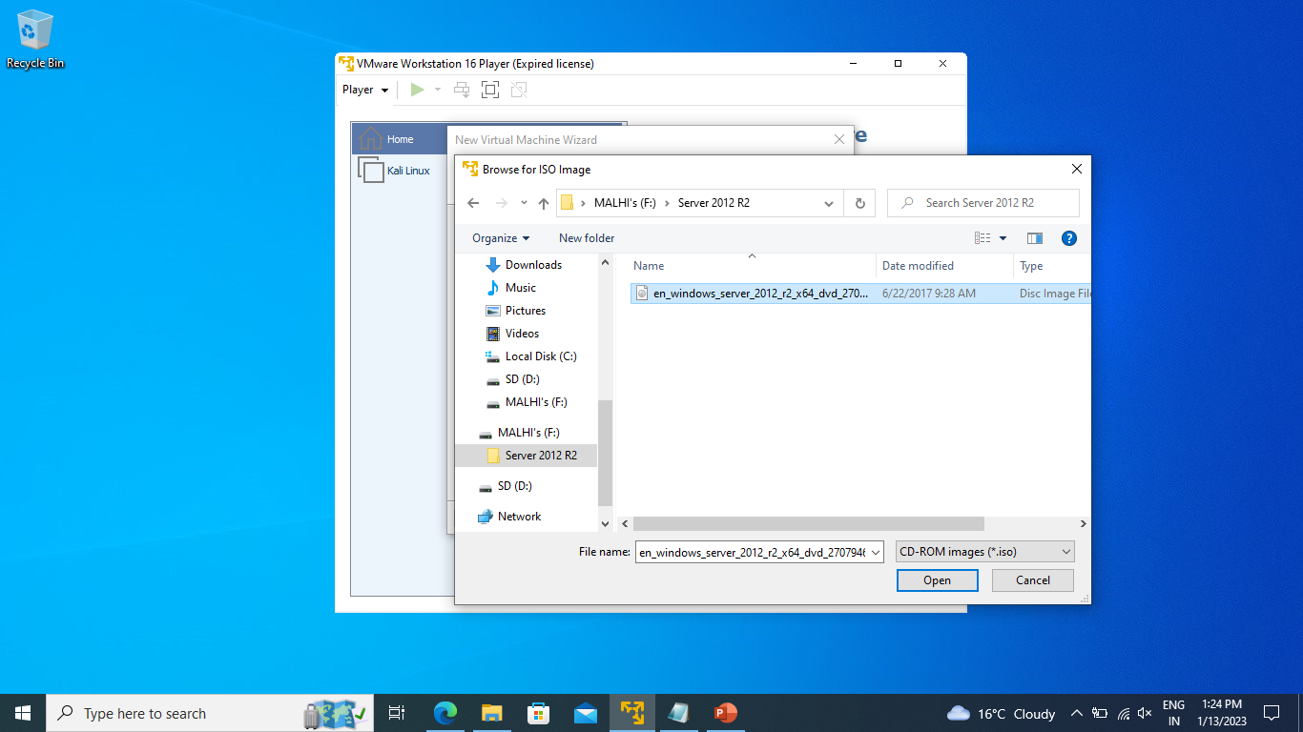

Slide 17
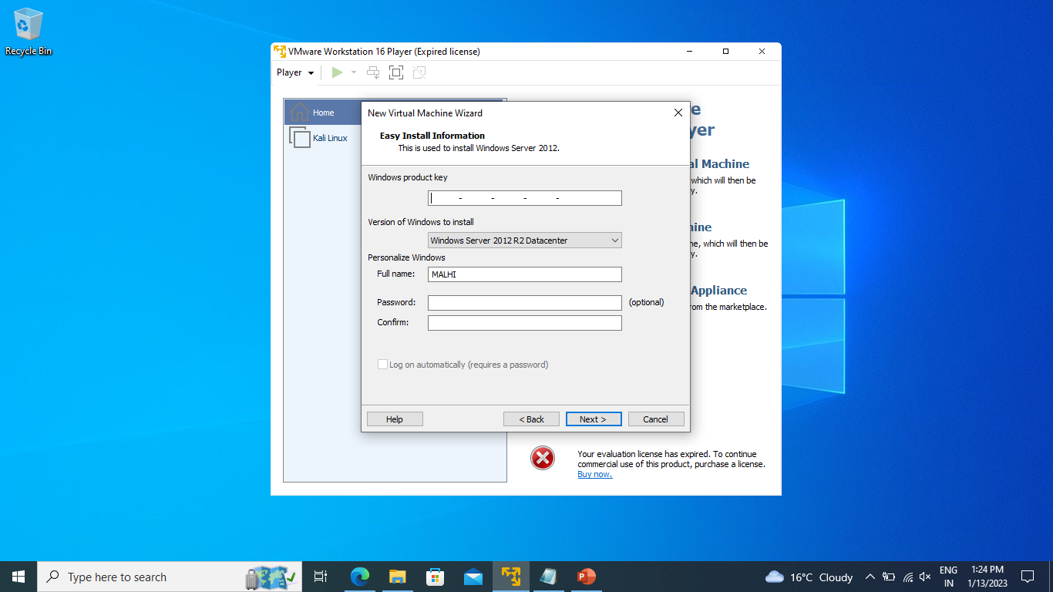

Slide 18


Slide 19


Slide 20
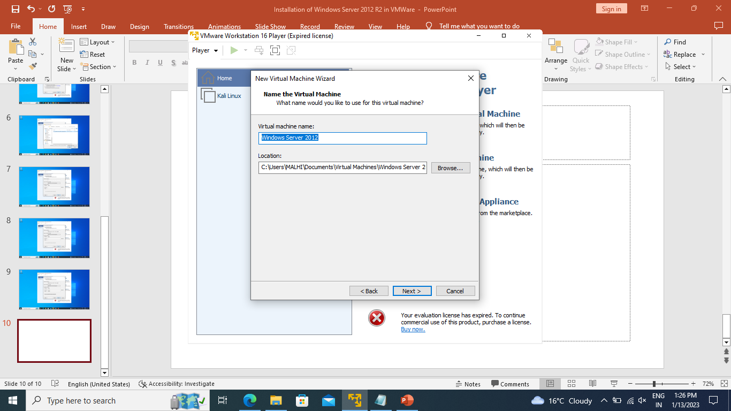

Slide 21
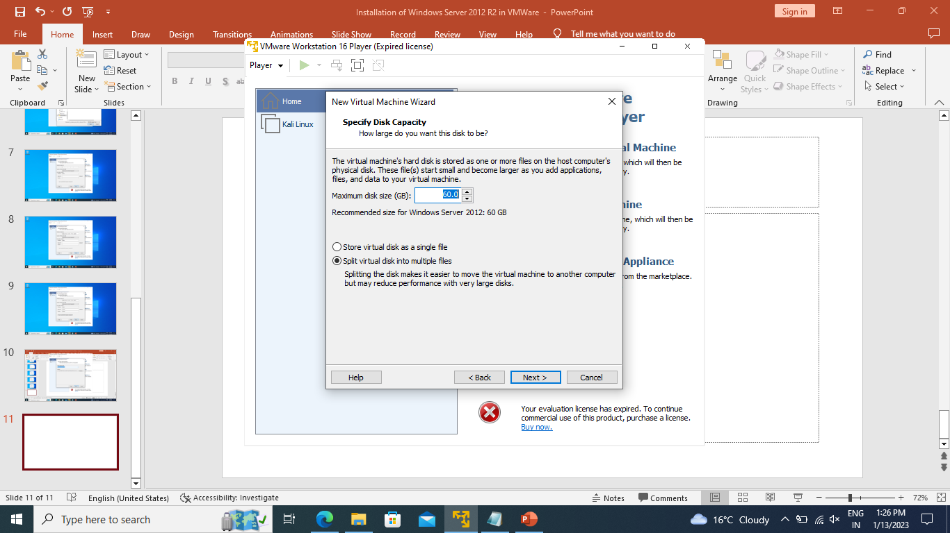

Slide 22
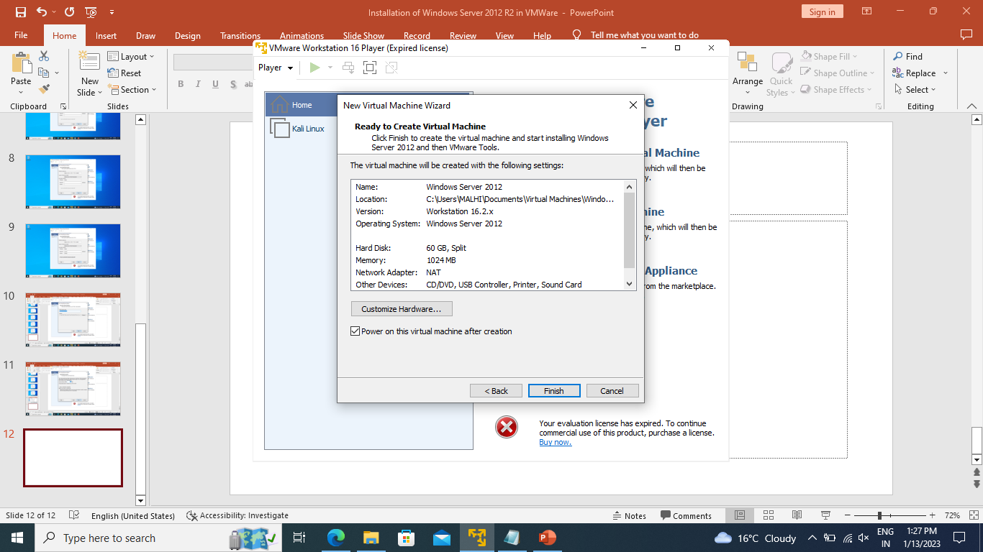

Slide 23
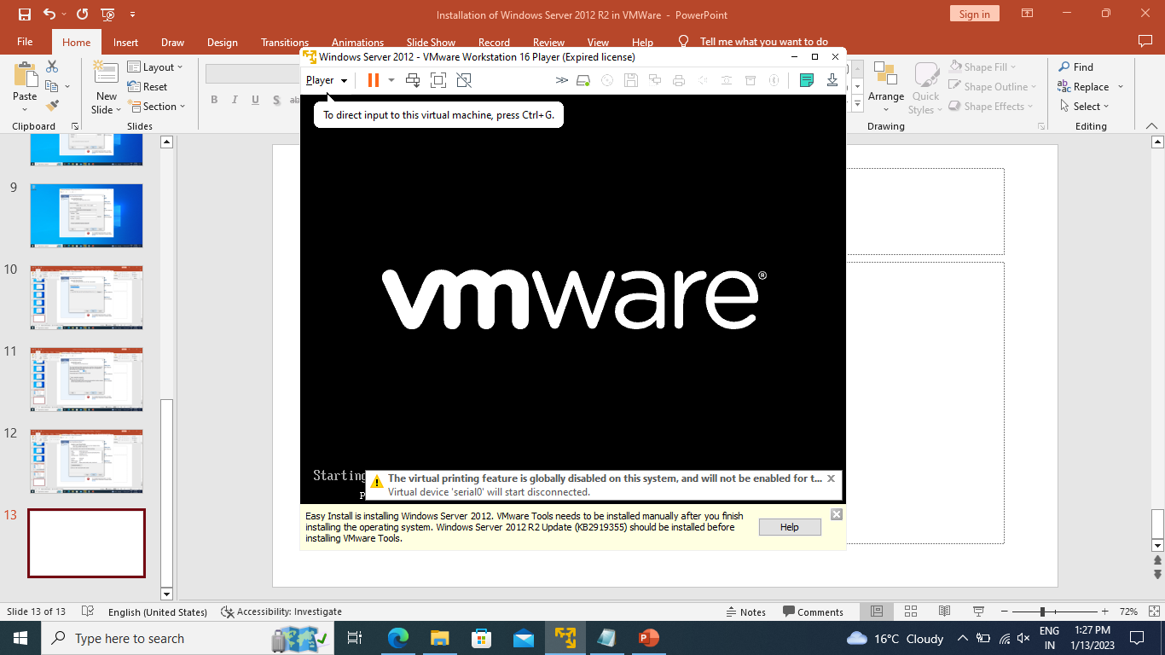

Slide 24
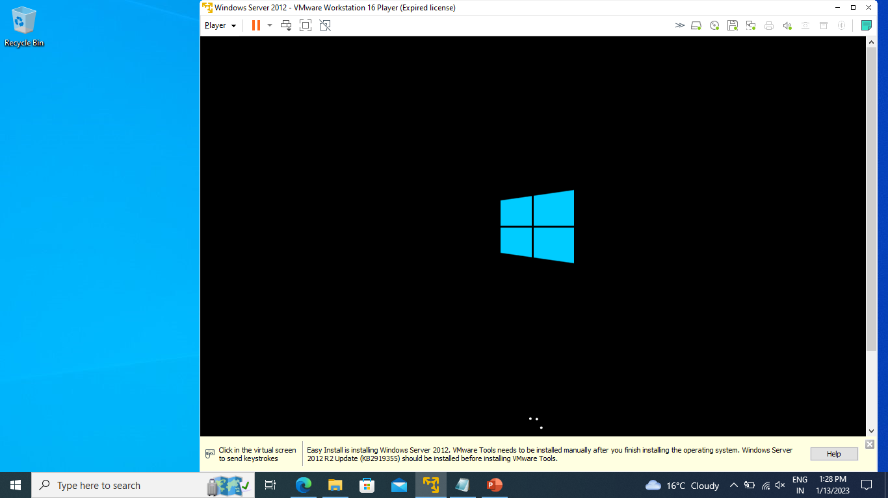

Slide 25
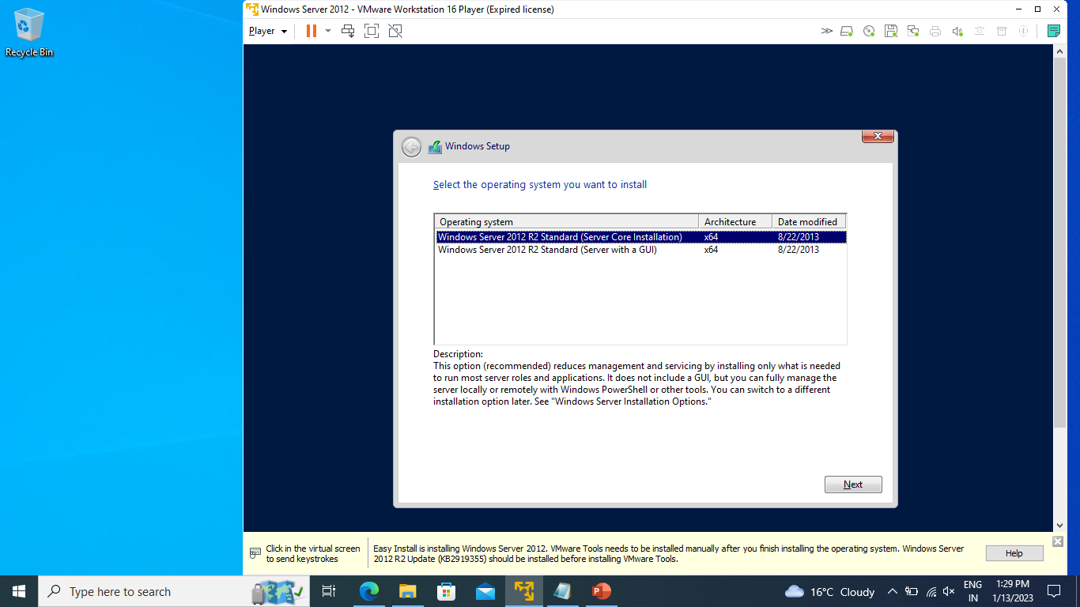

Slide 26
Select a Server with a GUI option

Slide 27
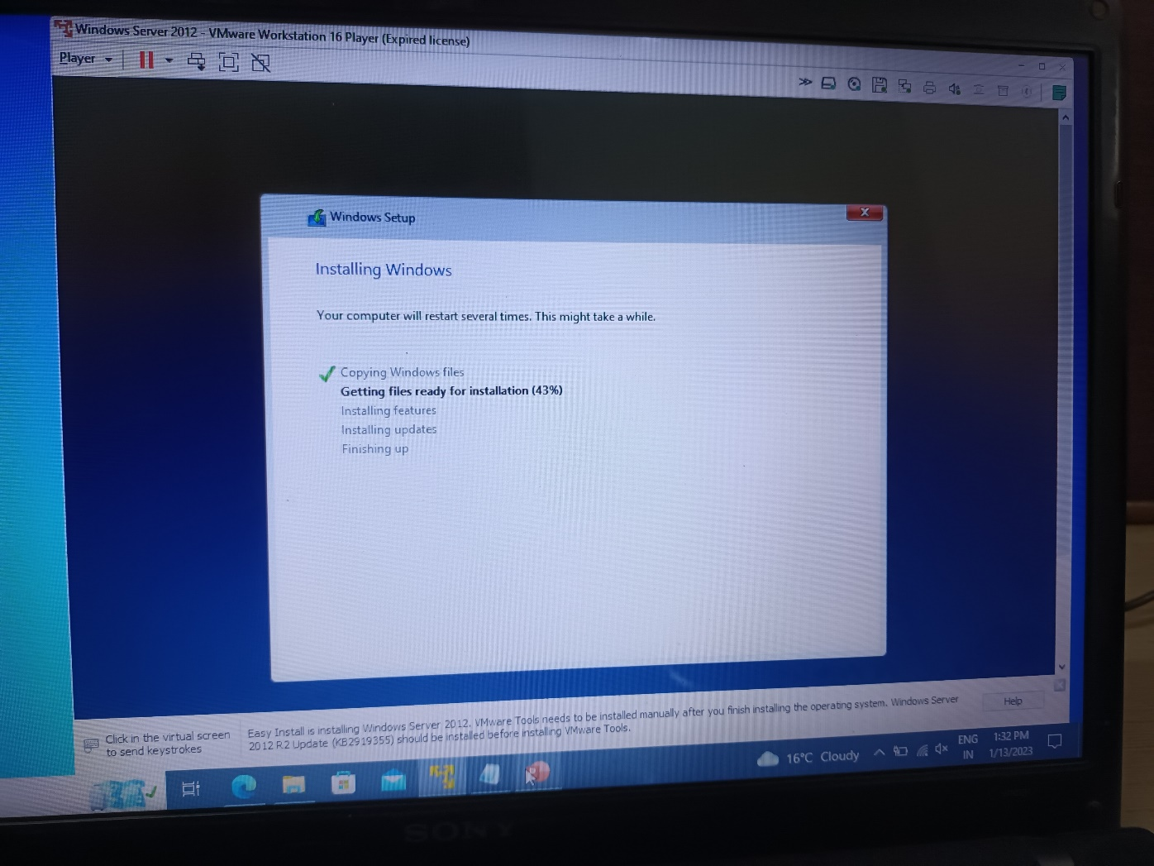

Slide 28
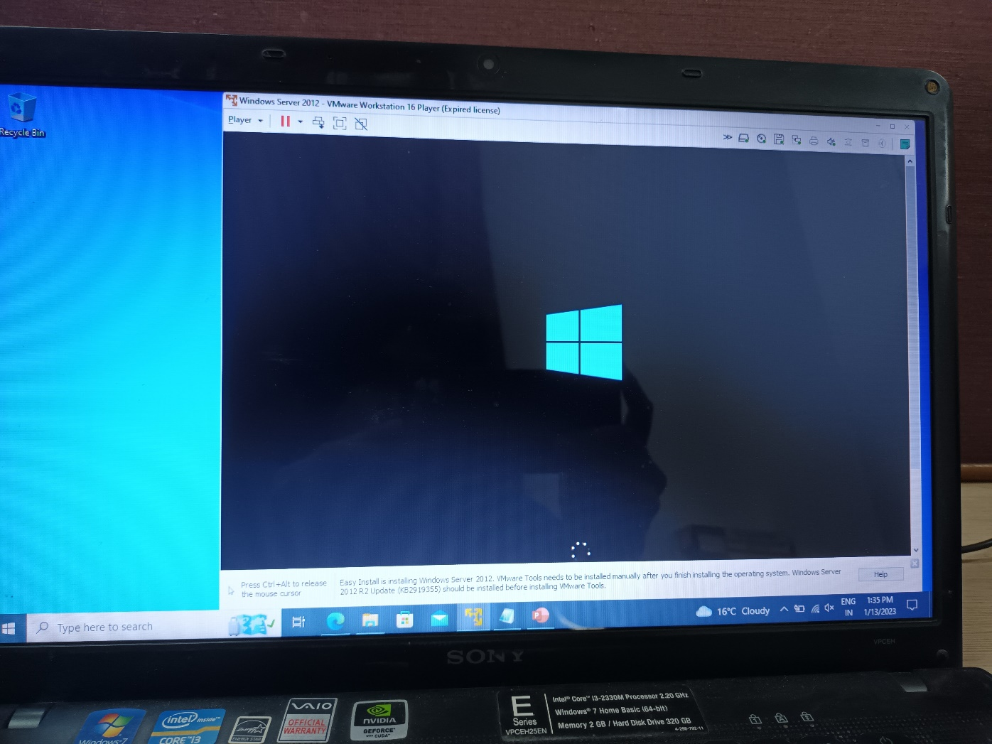

Slide 29
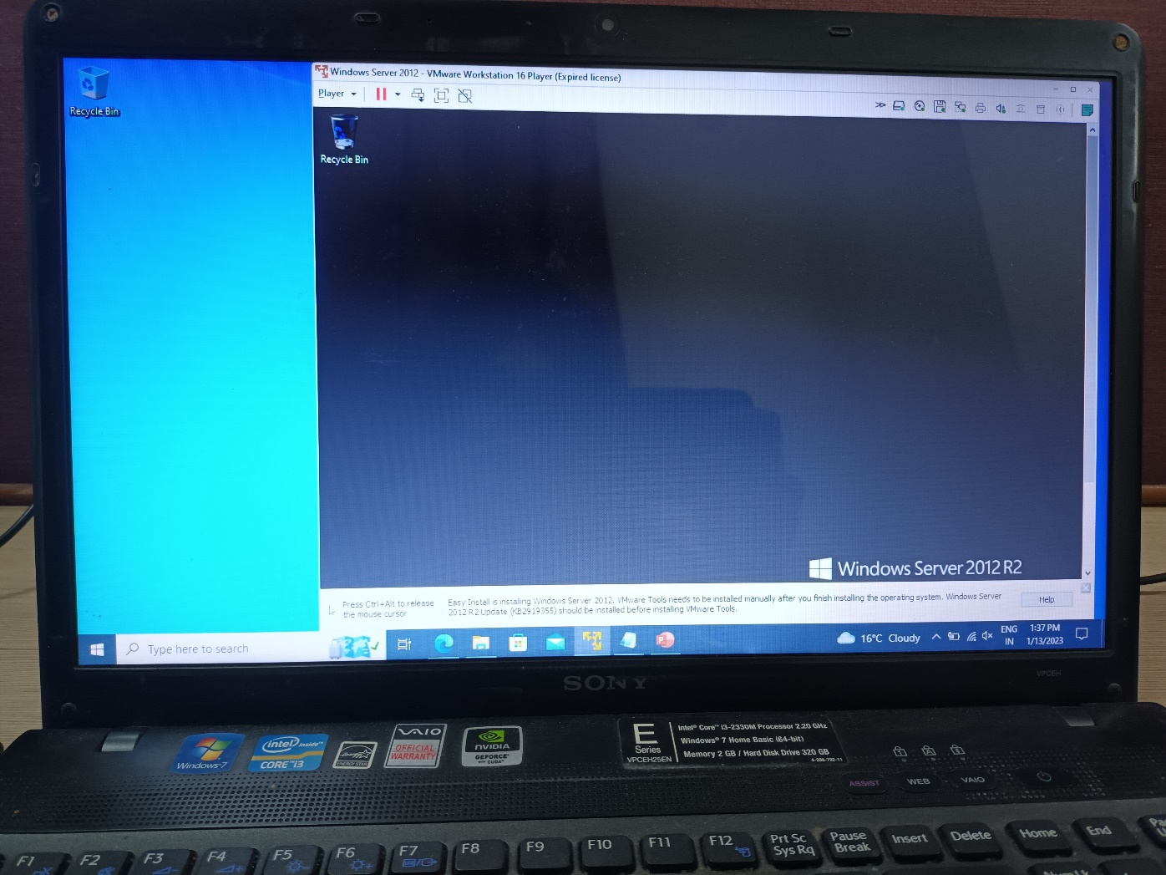

Slide 30
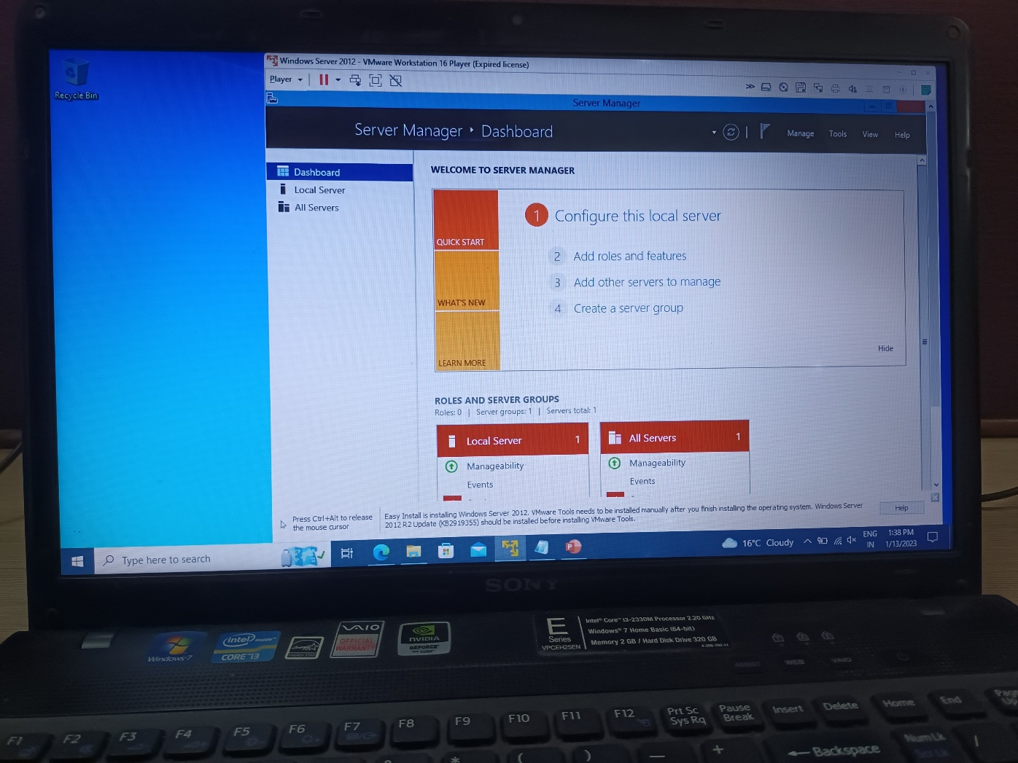

Slide 31
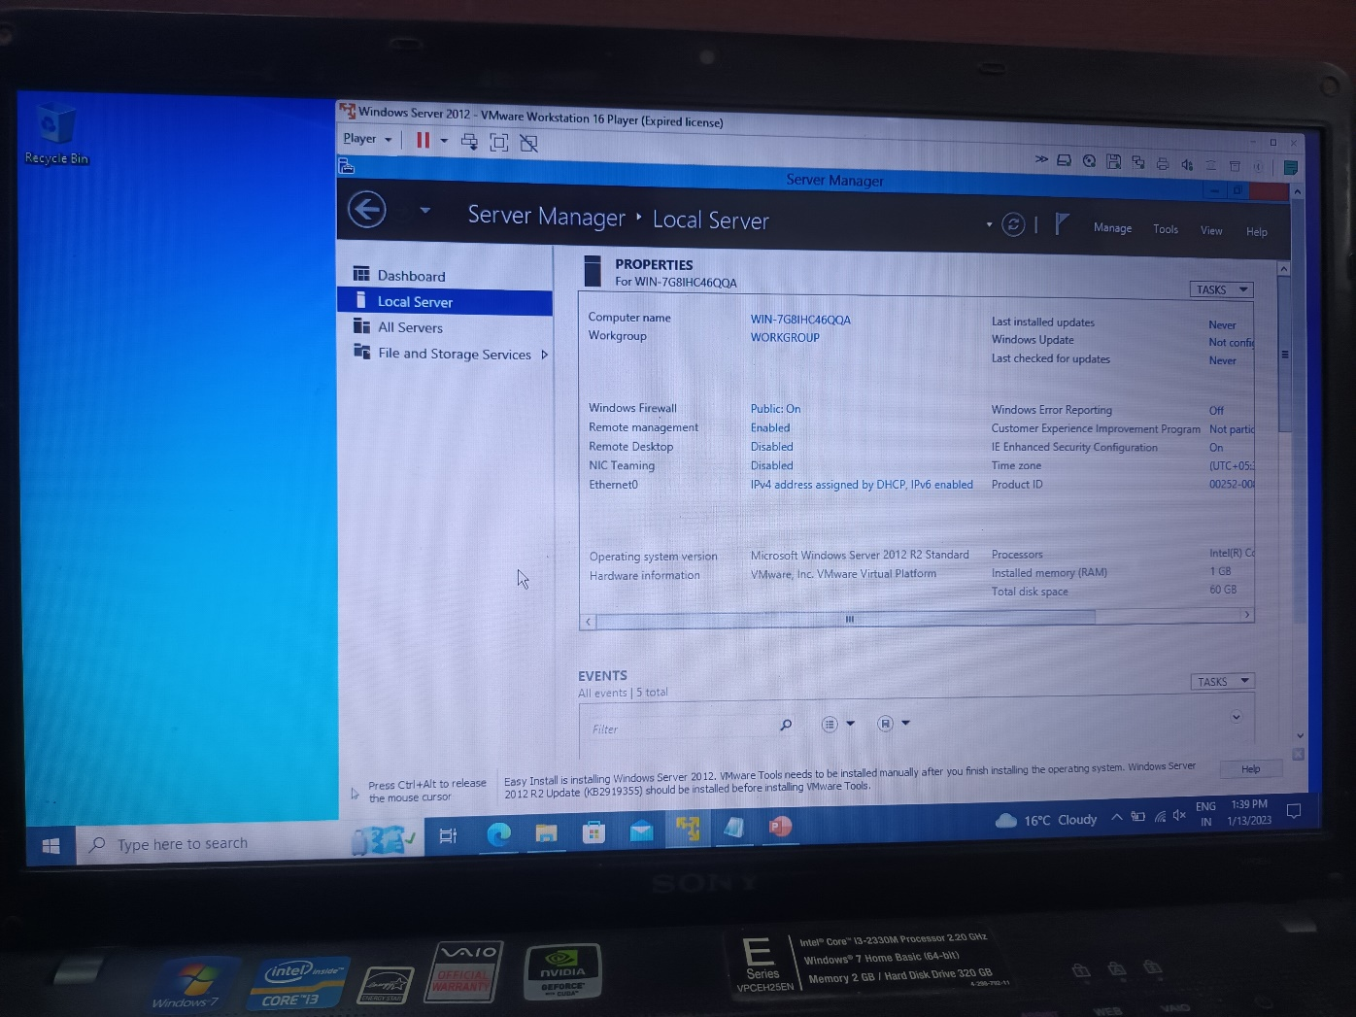

Slide 32
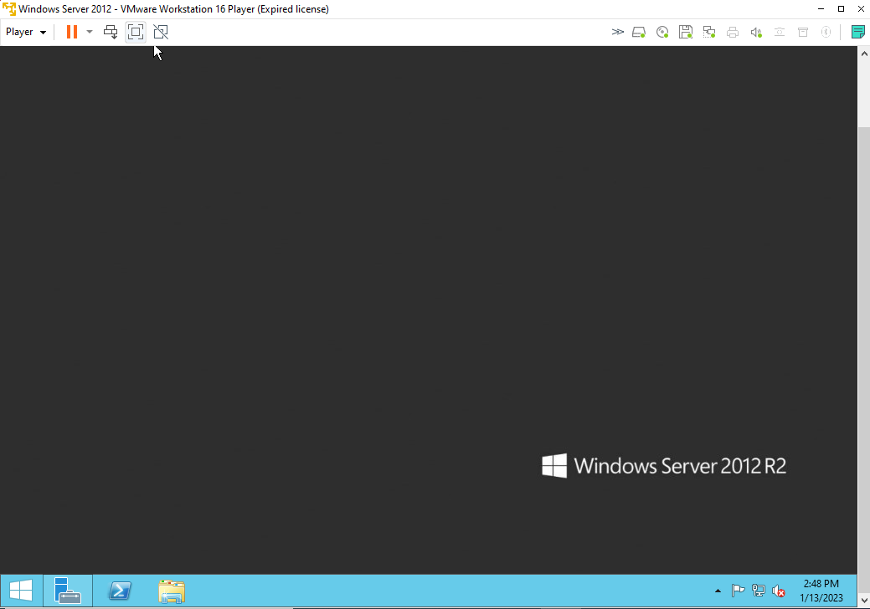

Slide 33
Question 1
What are the four phases of the server lifecycle?

Slide 34
Question 1
What are the four phases of the server lifecycle?
Purchase, install/deploy, maintain/update, decommission

Slide 35
Question 2
What are the four main subsystems of a computer?

Slide 36
Question 2
What are the four main subsystems of a computer?
Processor, memory, storage, network

Slide 37
Configuring Network
Manage network cabling,
Configure network interface cards,
Implement IP addressing and network infrastructure services

Slide 38
Manage network cabling,
To connect two or more computers or networking devices in a network, network cables are used. There are three types of network cables;
coaxial
twisted-pair
fiber-optic

Slide 39
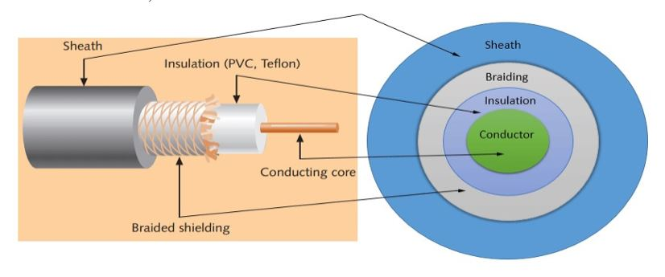
Coaxial cable
This cable contains a conductor, insulator, braiding, and sheath. The sheath covers the braiding, braiding covers the insulation, and the insulation covers the conductor.

Slide 40
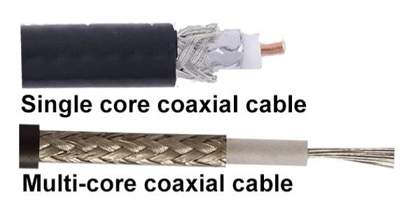
Coaxial cables are no longer used to build any type of computer network.

Slide 41
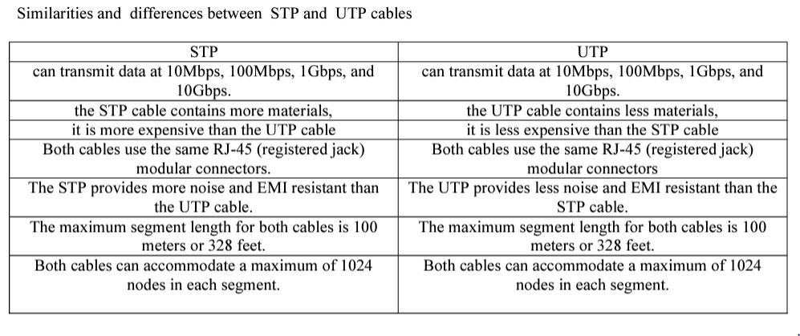
Twisted-pair cables
Usually, there are four pairs. Each pair has one solid color and one stripped color wire. Solid colors are blue, brown, green and orange. In stripped color, the solid color is mixed with the white color.
There are two types of twisted-pair cable
UTP and STP

Slide 42
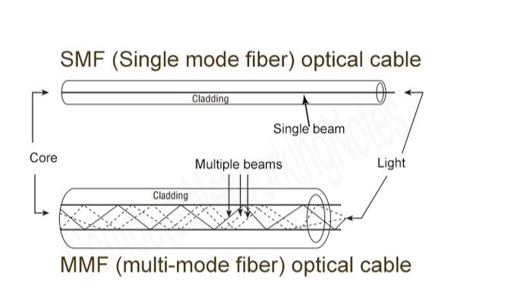
Fiber optic cable
This cable consists of core, cladding, buffer, and jacket. The core is made from the thin strands of glass or plastic that can carry data over the long distance. The core is wrapped in the cladding; the cladding is wrapped in the buffer, and the buffer is wrapped in the jacket.

Slide 43
IP Address Review
IP addresses are configured on each network node. At its most simple, the IP address contains two parts: the Network ID and the Host ID. The Network ID identifies which network segment or subnet the host belongs to, and the Host ID uniquely identifies a specific node within the subnet
Subnet masks allow administrators and computers to recognize which portion of the IP address is the Network ID and which portion is the Host ID.

Slide 44
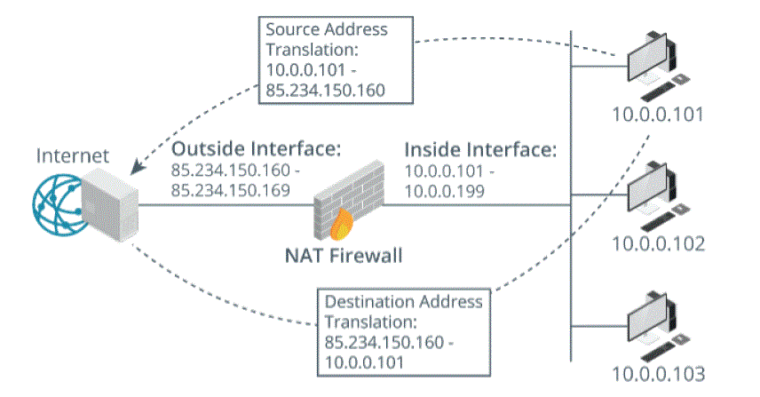
NAT
The reserved IP address ranges are for use inside company (and home) networks. The addresses in this range are not routable on the public Internet.
NAT is a service on some servers and routers that substitutes the organization’s single public IP address for any traffic originating from or addressed to internal devices that have reserved IP addresses.

Slide 45
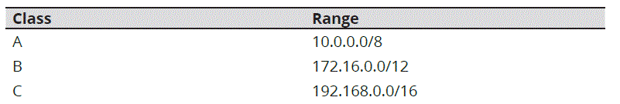
Reserved IP Address Ranges
The Request for Comment (RFC) that defines IP version 4 addresses divides the roughly 4.3 billion available addresses into five classes. Three of the five classes (Classes A, B, and C) are commonly used in networking.

Slide 46
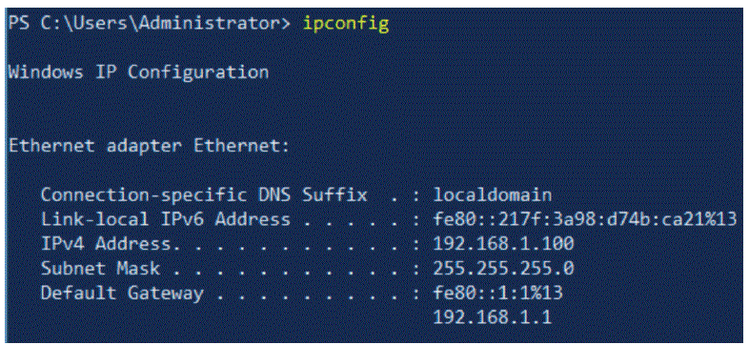
IPv6 Addresses
IPv6 addresses are 128 bits in length, providing approximately 3.4 x 1038 addresses, and the addresses are allocated more efficiently.

Slide 47
Network Devices
Routers operate at Layer 3 of the OSI model, function based on IP addresses, filter traffic, and link together one or more network segments.
Switches operate at Layer 2 of the OSI model, function based on Media Access Control (MAC) addresses, link network nodes that are near each other, and filter traffic between one or more network VLANs.
Gateways link two or more networks and may translate between network protocols. Routers are a type of gateway.
WAPs are gateways that link wireless devices together and attach the wireless
network to the wired network.
Media consists of the network cabling that links computers to routers, switches, and
gateways. Common media types include twisted pair Ethernet cable, co-ax cable,
and fiber optic cable.

Slide 48
Network Firewalls
Firewalls filter network traffic, allowing administrators to control traffic that moves between two networks, between two network segments, or even in and out of an individual workstation or server. Firewalls may be software running as a service on a computer or a dedicated hardware device.
Most firewalls generate log files. Regularly review these log files for suspicious activity, for frequently blocked connection attempts, and to ensure the accepted connections are from expected sources using expected protocols. Some firewalls can alert administrators to suspicious activity.

Slide 49
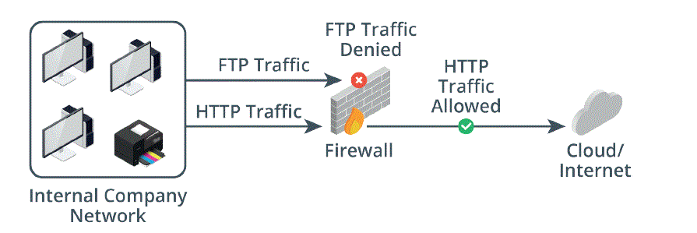
Network firewalls are found between network segments or between two separate networks. For example, an administrator might implement a simple packet filtering firewall between the Financial Department's segment and the Engineering Department's segment.

Slide 50
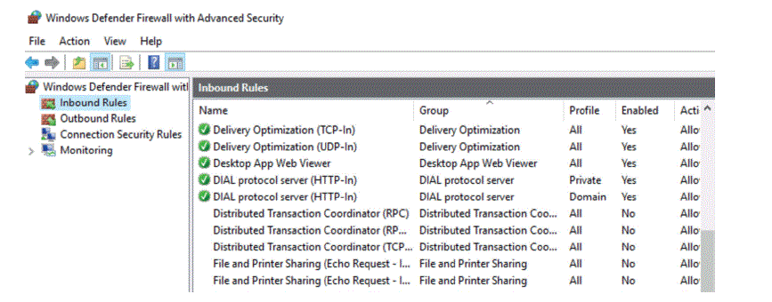
Host-Based Firewalls
Host-based firewalls control traffic flow in and out of the host server's NIC. Host-based firewalls protect the server from different threats than do network firewalls. Network firewalls protect the perimeter, while host-based firewalls protect each individual host inside the perimeter. Both are important.

Slide 51
Network Access Control (NAC)
NAC defines rules for valid computer configuration and then enforces those rules when a device attempts to connect to the network.

Slide 52
Question
What is the difference between a host-based firewall and a network based firewall?
What are the Class A, B, and C reserved IP address ranges, and what is their purpose?

Slide 53
NIC Teaming
NIC teaming allows you to combine multiple physical network adapters into a virtual NIC, which will then be presented to the operating system (OS) as a single NIC. All the incoming traffic from the OS will pass through the virtual NIC and be load-balanced across the assigned physical network connections.
This technology offers system administrators a simple solution for link aggregation, load balancing, failover, and Software-Defined Networking (SDN).

Slide 54
Benefits of NIC Teaming
Increase of load-balancing capabilities.
Breakup of network traffic across multiple connections.
Strengthens failover, reducing single points of failure and creating redundancy when an NIC is designated as a hot spare.
Increases network reliability and continuity.
Ensures server availability and increases bandwidth.
Simplifies network configurations.

Slide 55
NIC Teaming Modes
Switch Independent Mode
If this mode is on, you can connect different network adapters to different switches. This is the only teaming mode that doesn’t require configuration changes on the connected switches. Switch Independent Mode uses media access control (MAC) addresses to manage incoming data.
LACP Mode
This mode requires enabling LACP on both the team and the switches. LACP mode provides load balancing and failover for both inbound and outbound traffic, and it supports dynamic changes in the team membership or switch configuration.
Static Mode
Static Mode requires you to manually configure the ports on the switch that connects with the NIC team. These ports should be configured into a Link Aggregation Group (LAG).

Slide 56
How to Set Up NIC Teaming on Windows Servers
Open the Server Manager and click on Local Server.

Slide 57
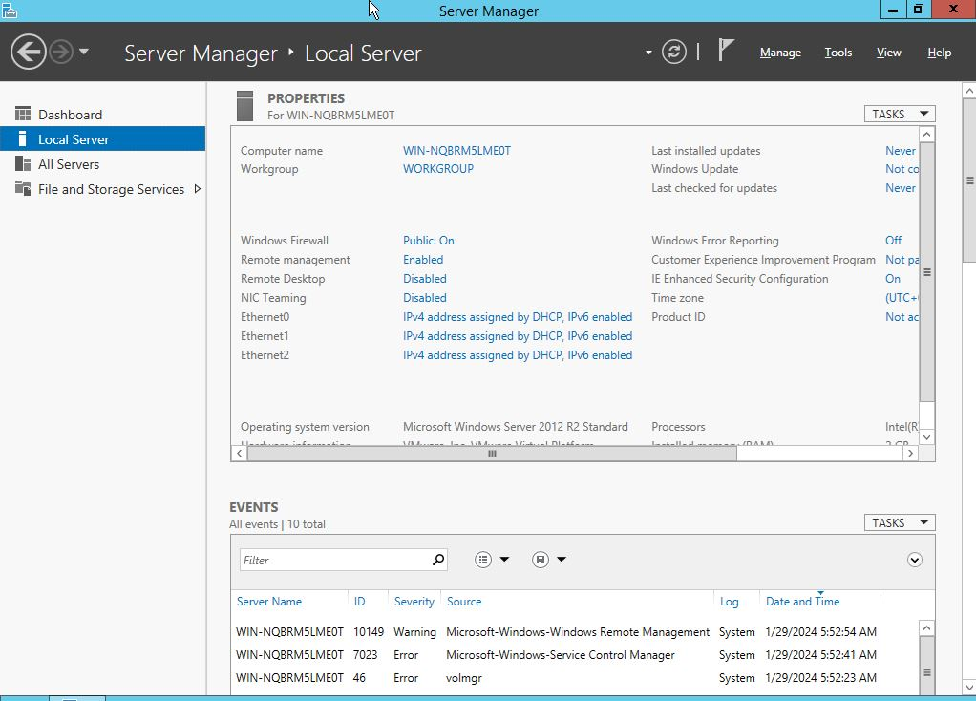
NIC Teaming is disabled by default on Windows Server. To enable it, find the Properties pane, locate NIC Teaming, and then click Disabled to the right. The NIC Teaming dialog box will open.

Slide 58
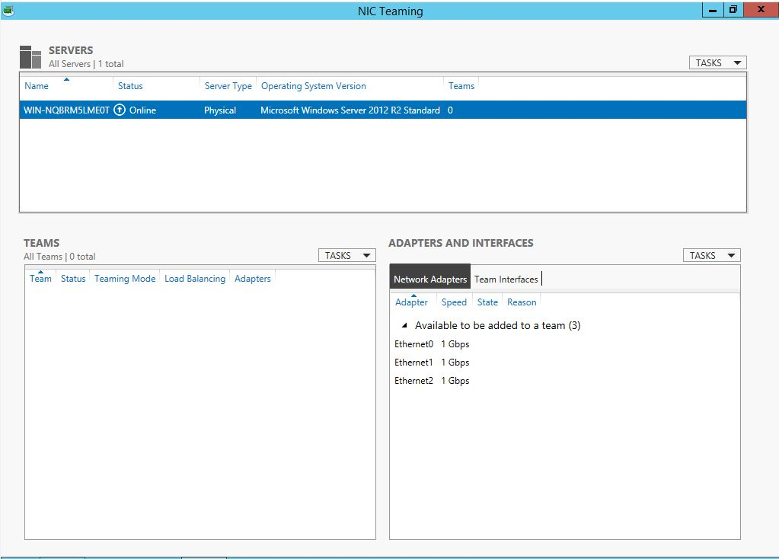

Slide 59
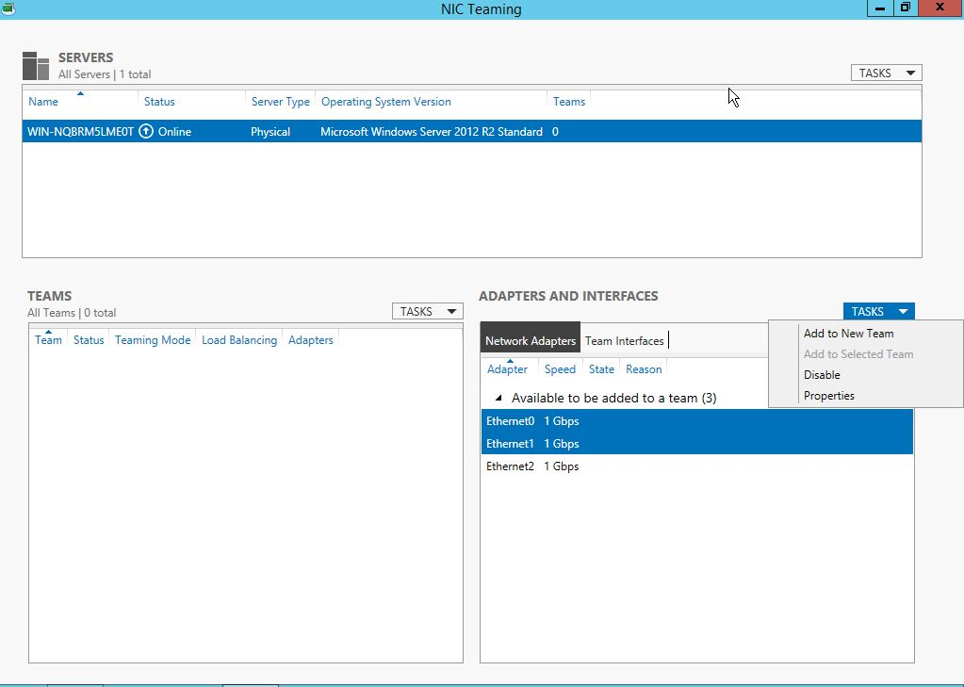
In the bottom right, under Adapters and Interfaces, select the network adapters you want to add to an NIC Team.
Now, Click TASKS and select Add to New Team from the drop-down menu.

Slide 60
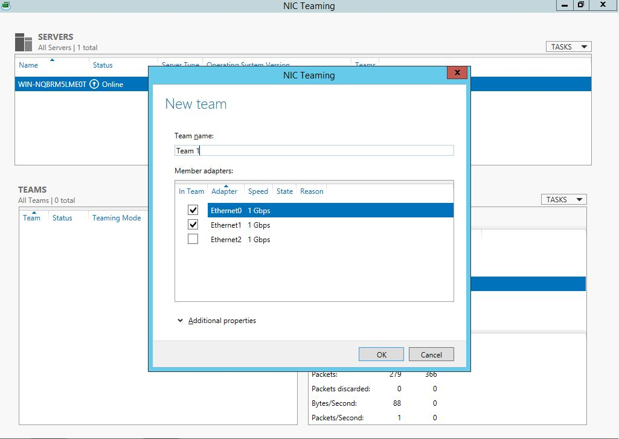
The New Team box will open and display the network adapters and team members. Type in the Team name for your new NIC Team.

Slide 61
At the bottom of the New Team box, click on Additional properties and select the NIC Teaming mode you want to use: Switch Independent, Static Mode, or LACP Mode. In this step, you can also select the load-balancing mode. Experts recommend it to be set to Dynamic for best performance.
When you’re done, click OK. Your new NIC Team will be created.
You can configure or assign a VLAN number to the new NIC Team you created. To do this, click the link to the right of the Primary team interface. The New team interface dialog box will open. Now click on Specific VLAN and type the VLAN data.

Slide 62
9. Update IP address of your NIC Team.
10. Ping from Client machine to the Server.

